Slide 1
Net.art project
By serena sharar

Slide 2
Project description
I took a single paragraph from 3 different sources and randomized them to find a single unique sentence.

Slide 3
Final Phrase
The decline weeks before they left

Slide 4
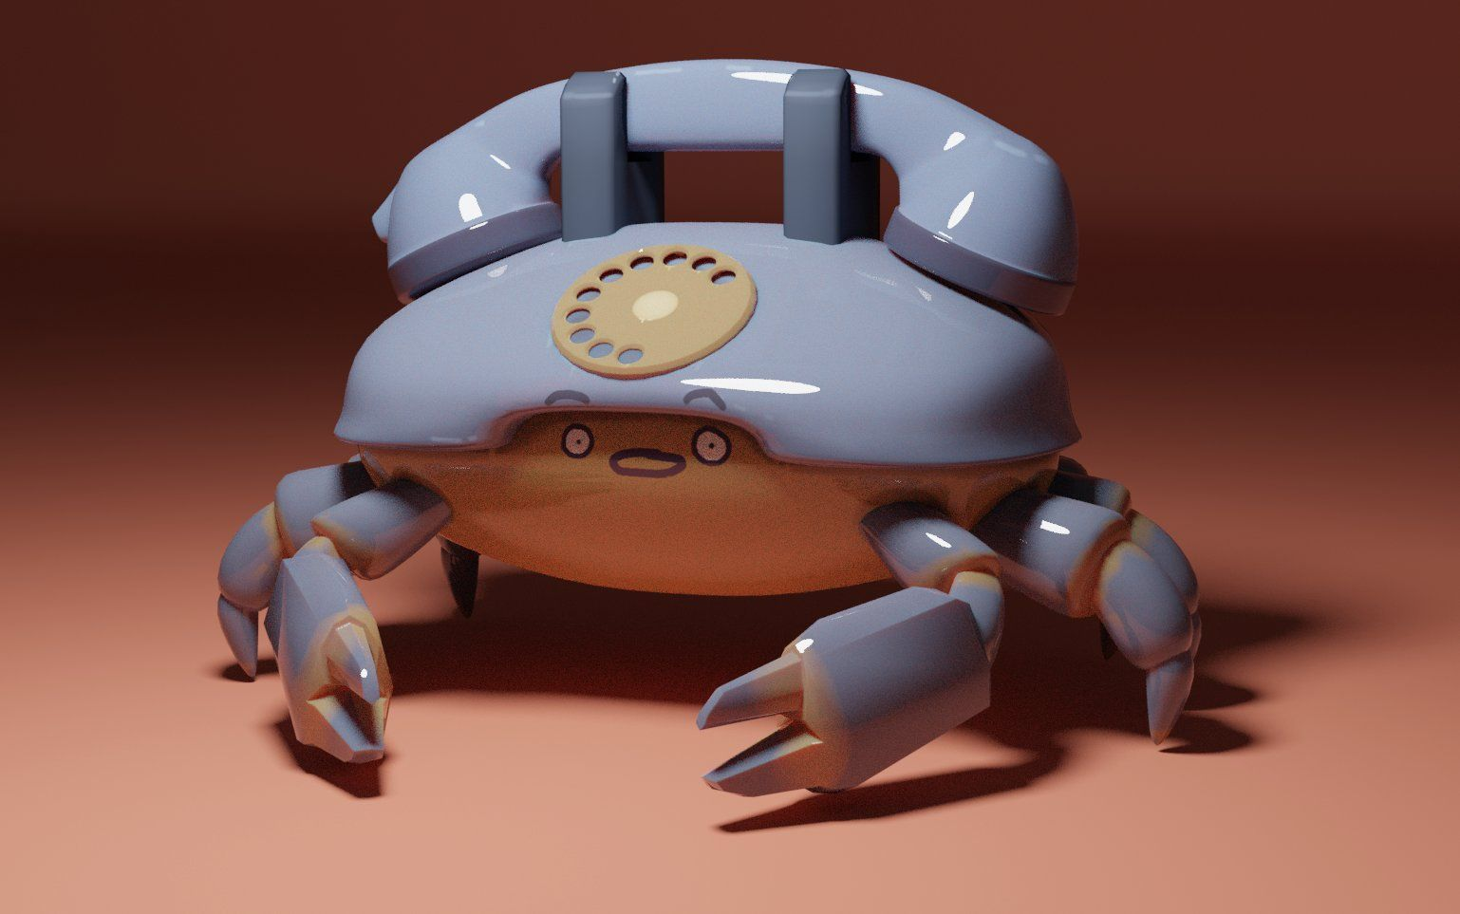
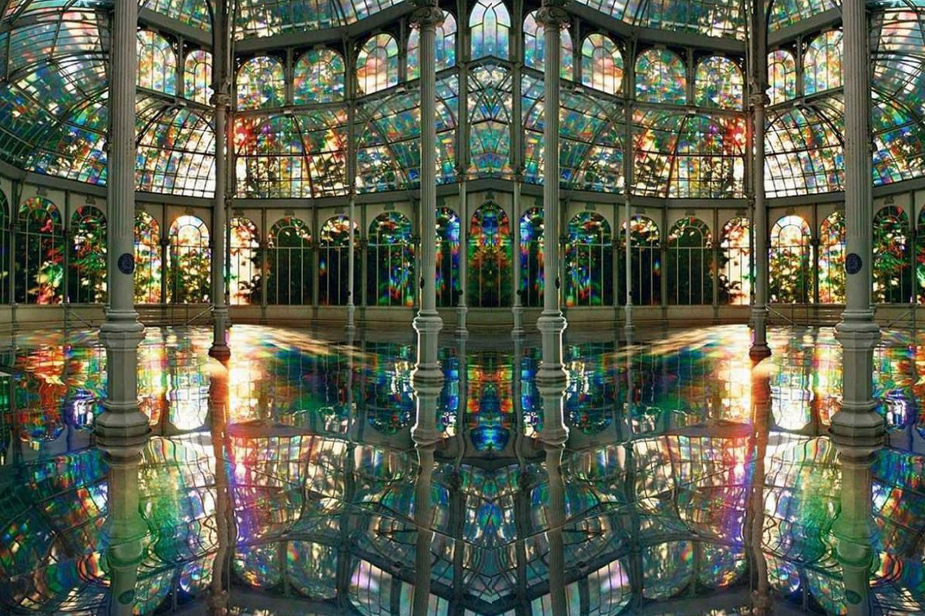
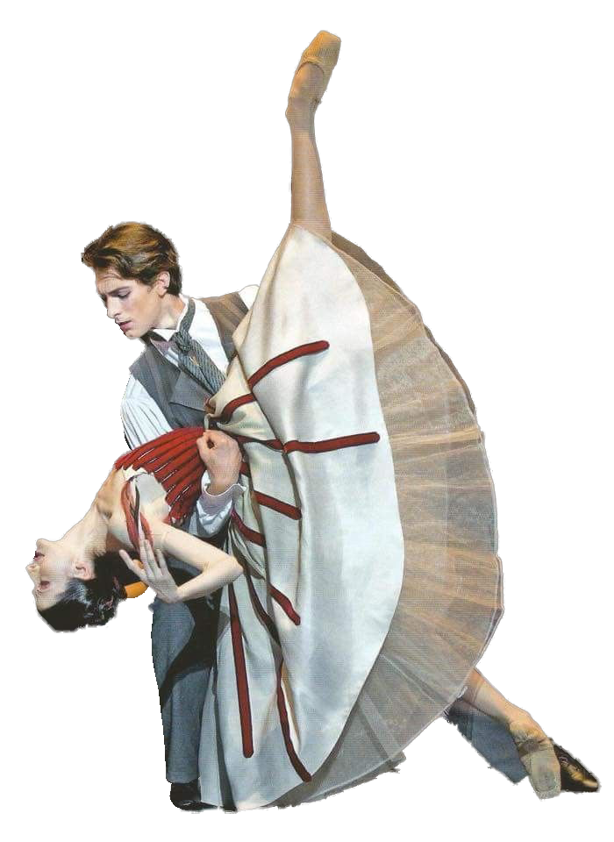
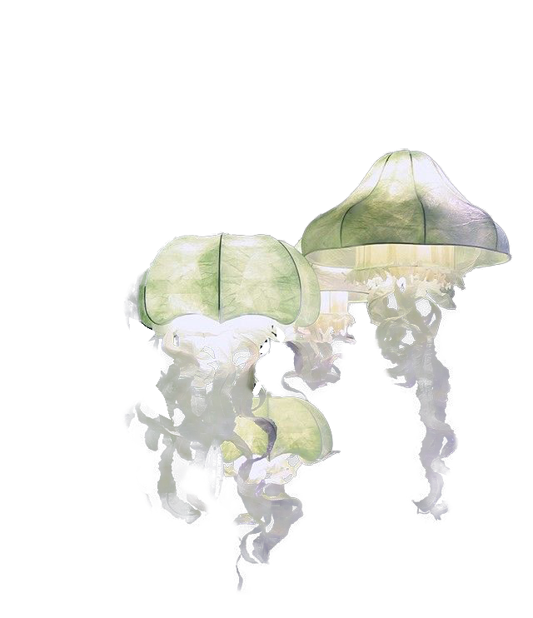
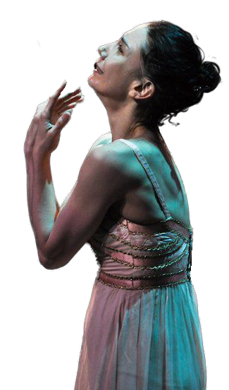
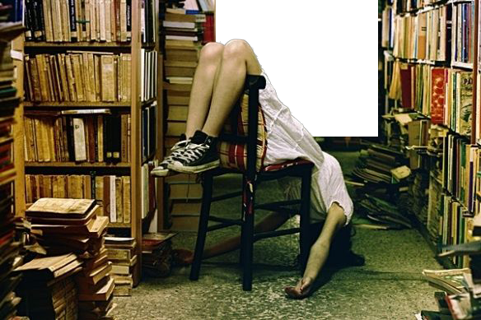
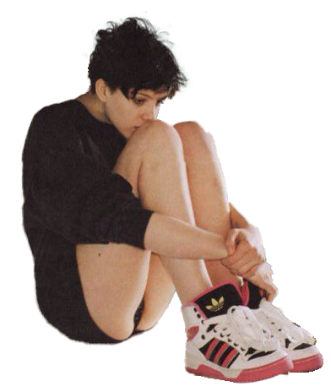
Images I’ll be using

Slide 5
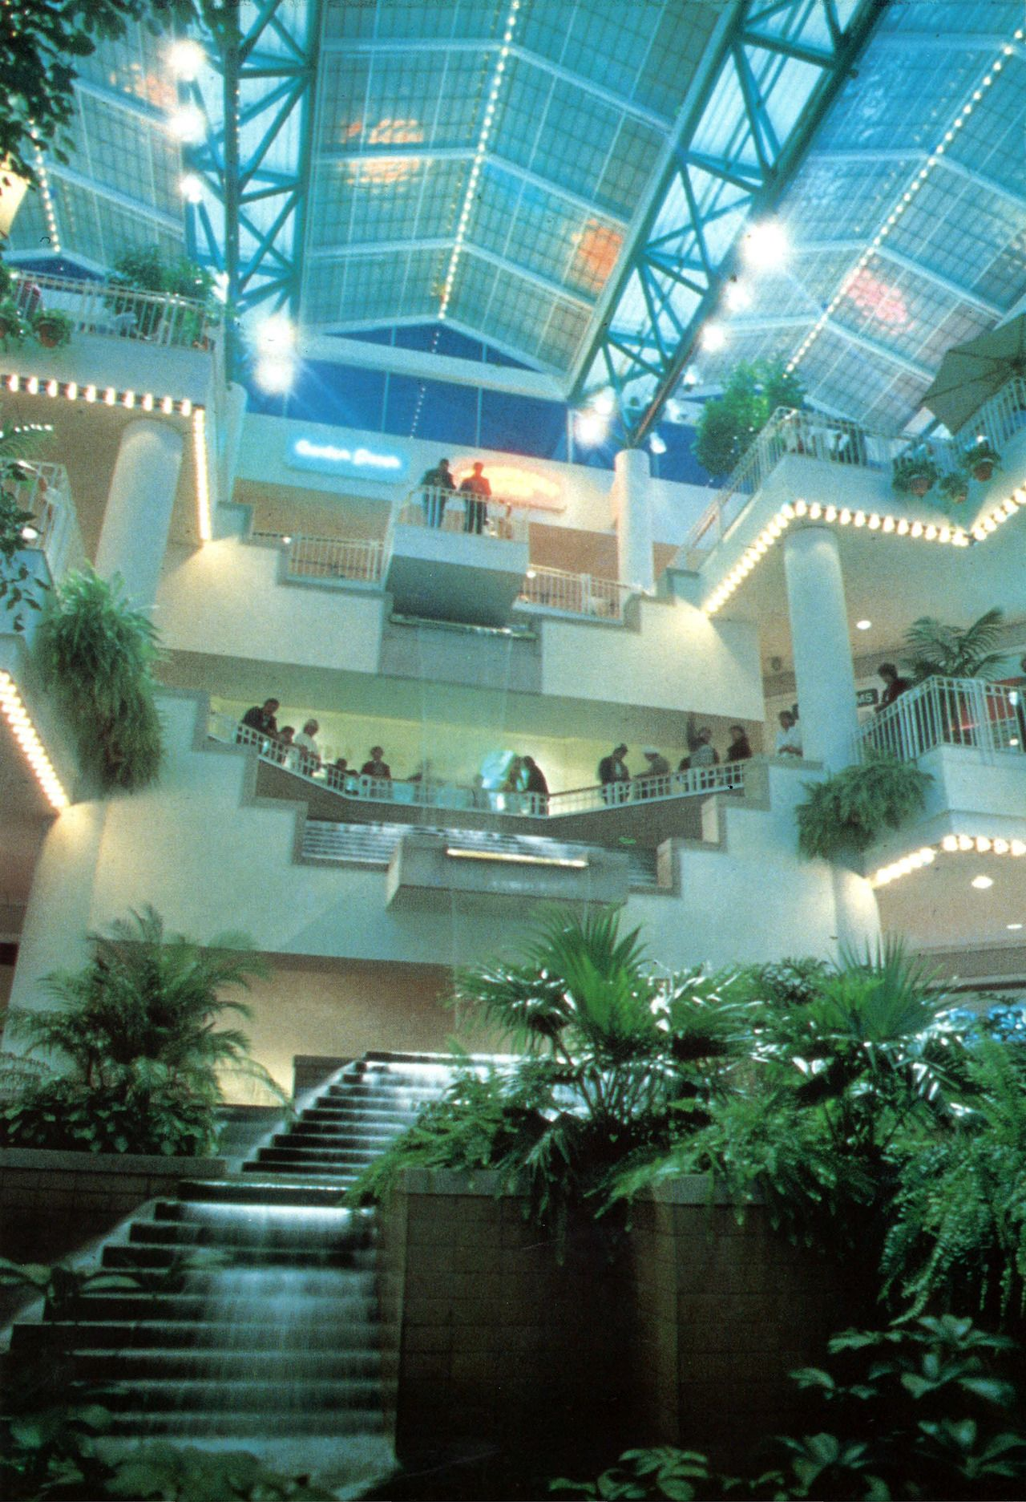
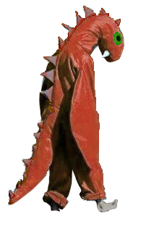
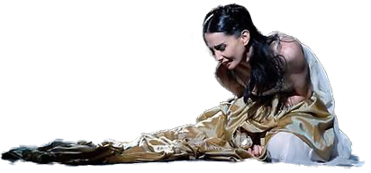
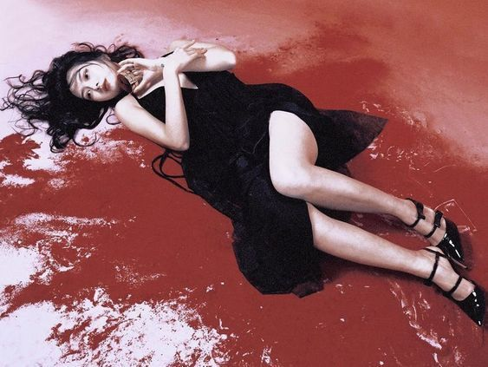
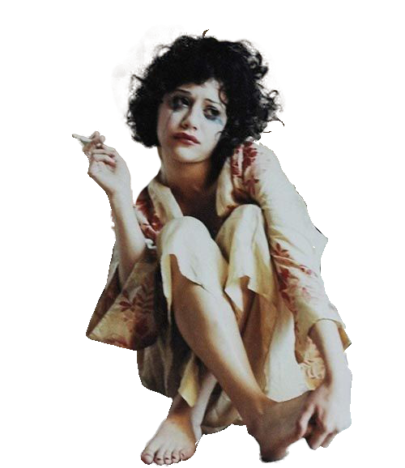
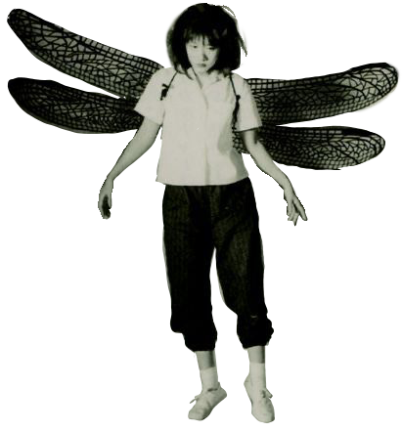
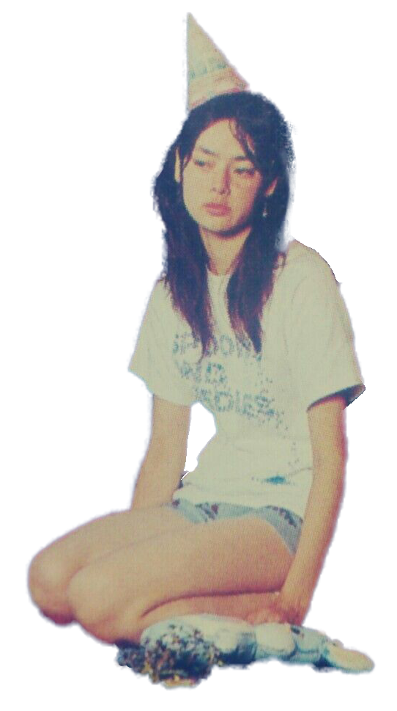
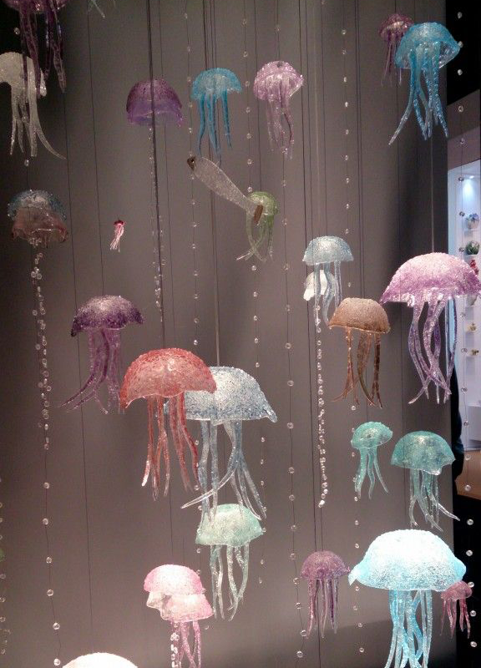
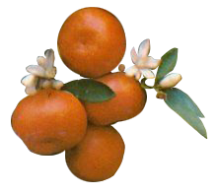
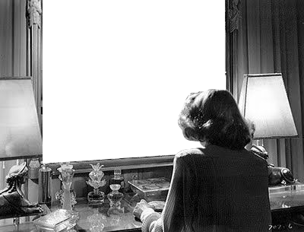
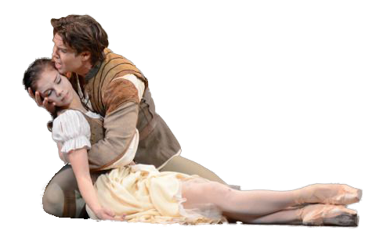
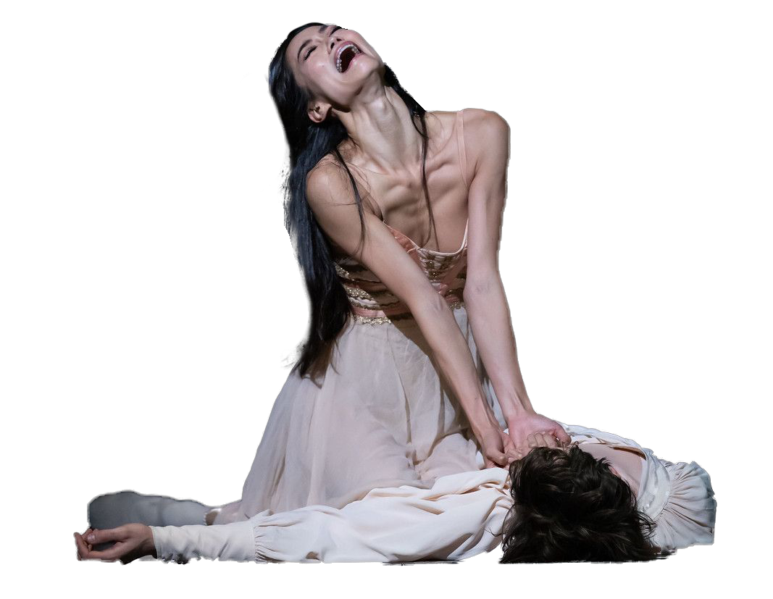
Cont.

Slide 6
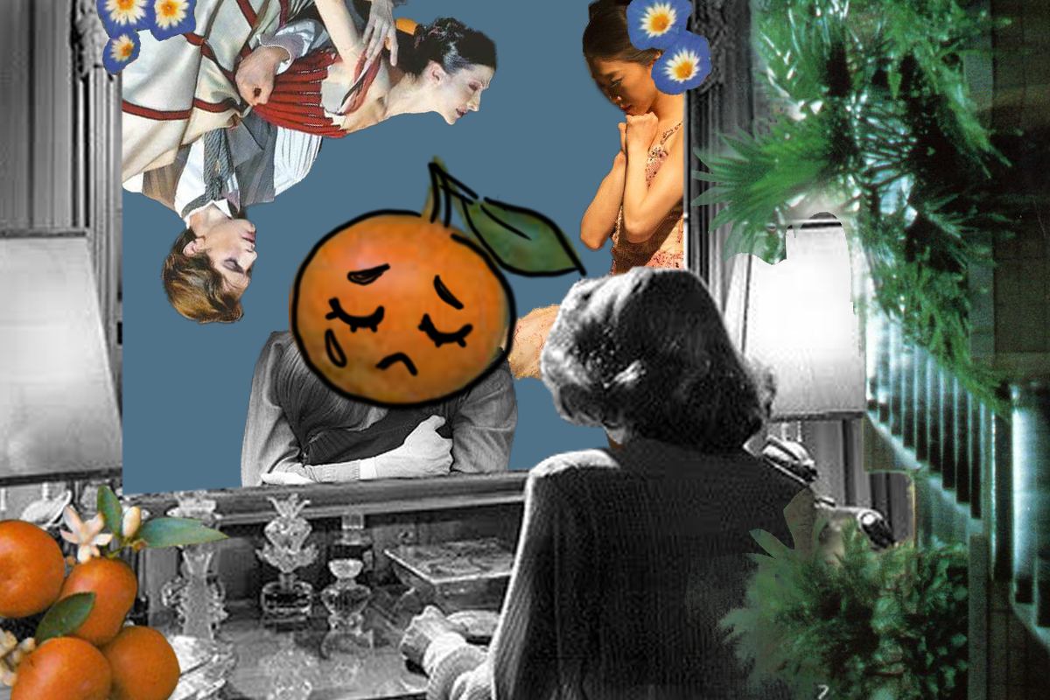
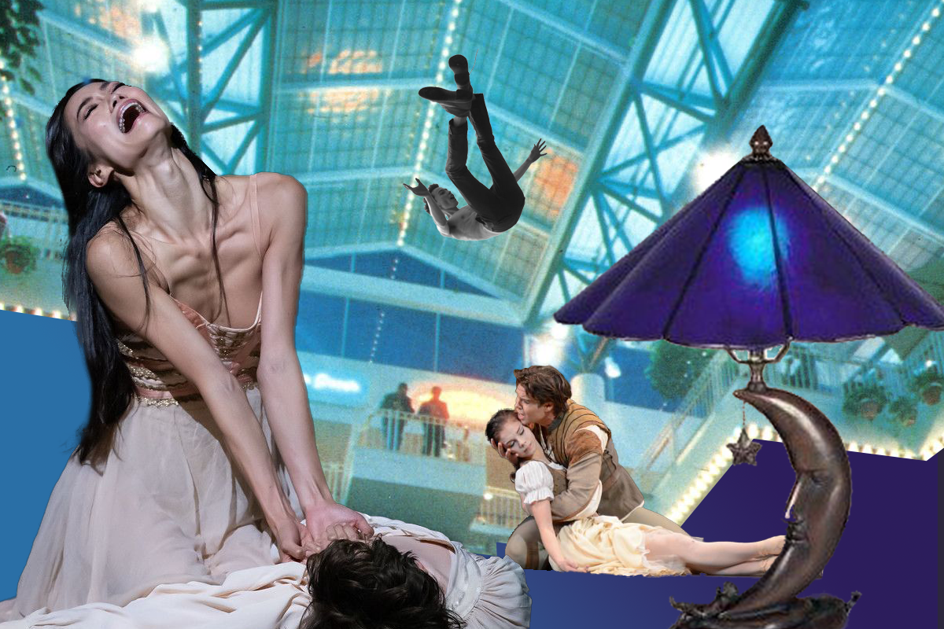
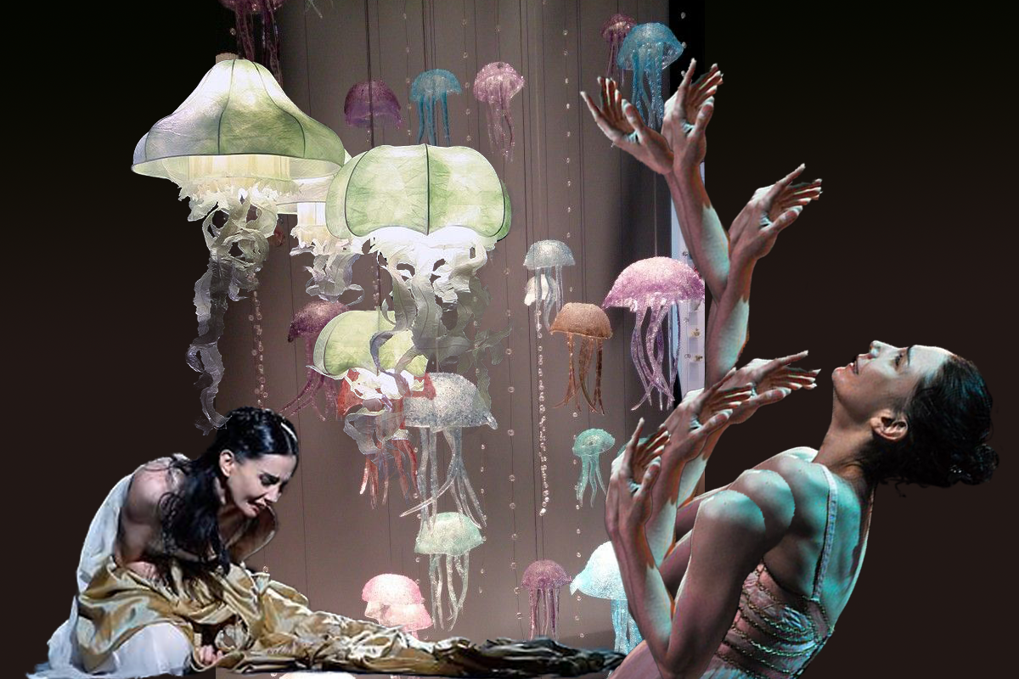
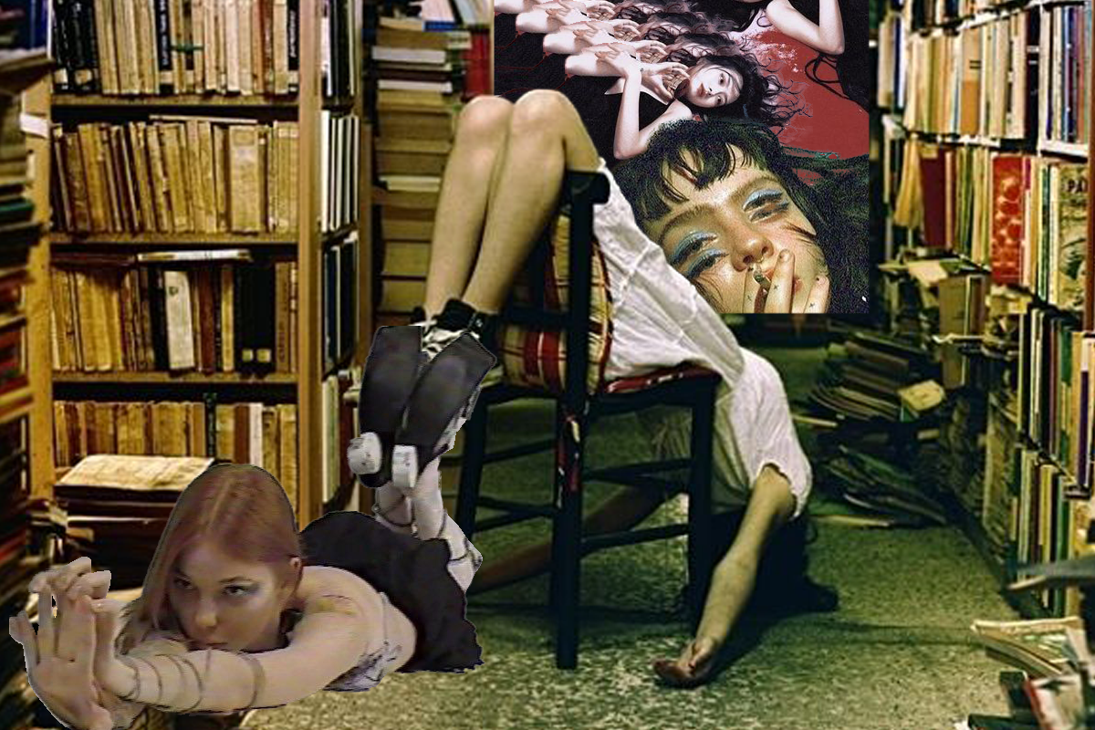
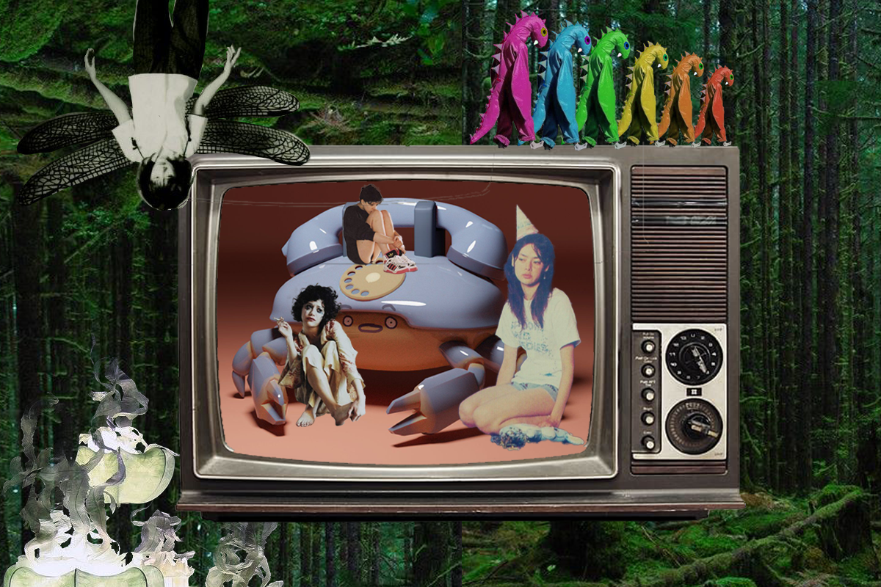
Drafts

Slide 7
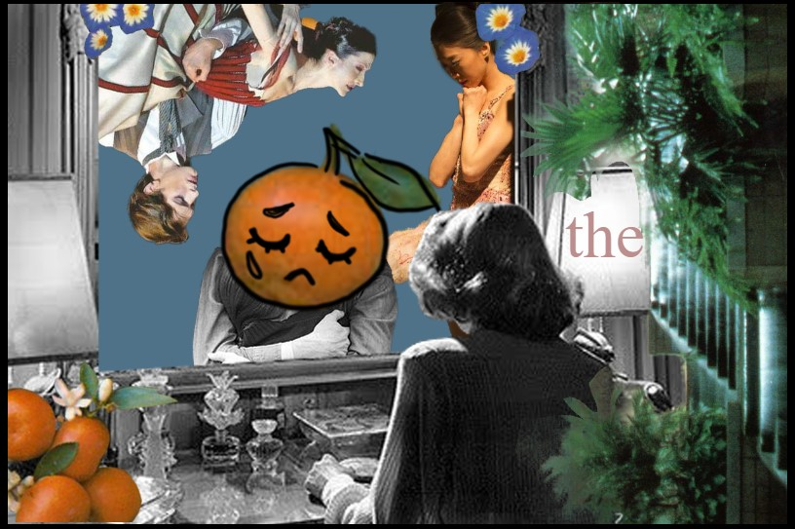
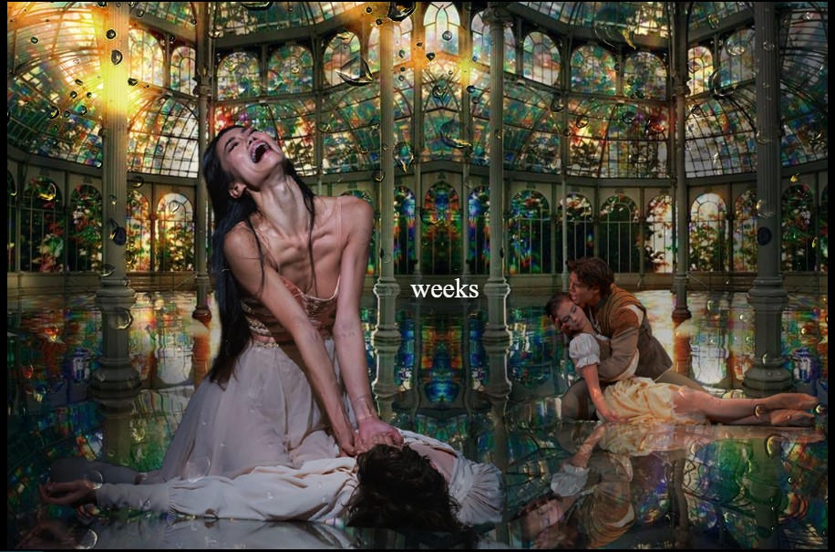
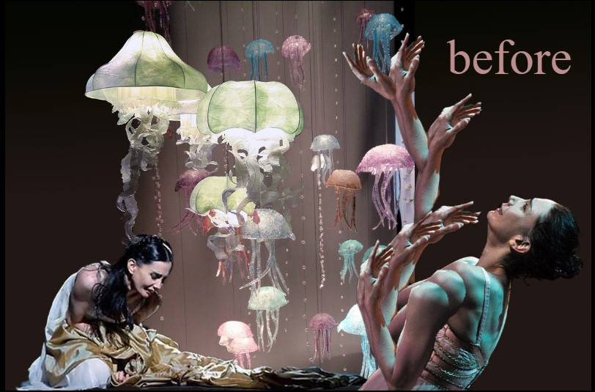
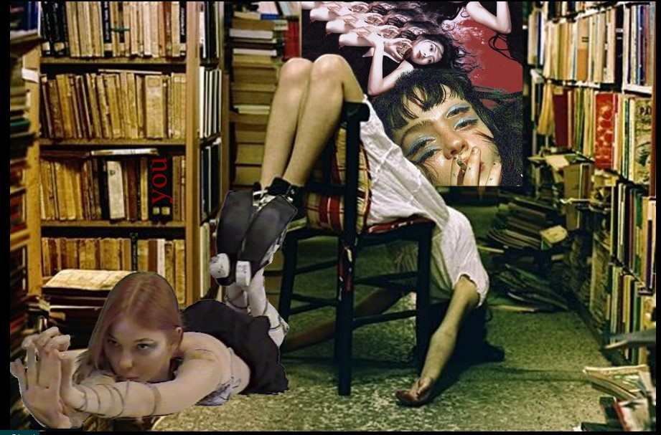
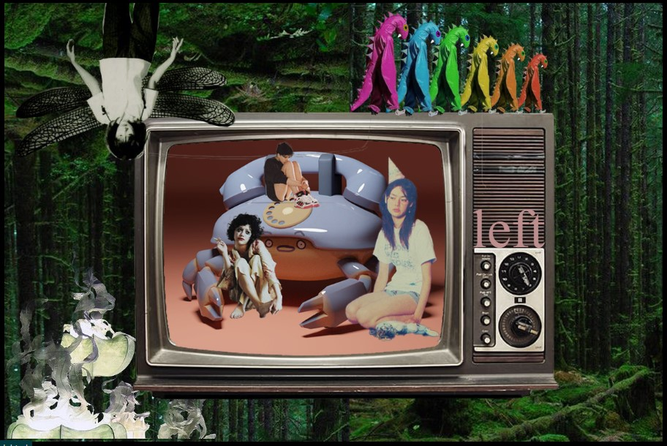
Final Product and Cheat Sheet

Slide 8
Artist statement
This project is based off the sentence “The Weeks Before You Left”. I found images on the internet to collage in CSS in 5 different pages.
They do not represent each word individually, but to symbolize the stages of grief before, during, and after a traumatic event takes place.
I made the project a search and find to add interactivity with the audience – to allow the eye an almost forced movement in order to delve deeper. Additionally, it connects to the theme of grief by literally searching for the words. I struggle with communicating about grief in my personal life whether I can't find the right words or break down completely and cannot don't say anything.

Slide 9
Reflection
This was a great project to show off everything I learned this semester. I was able to improve my photoshop skills and was surprised that that was the most grueling part of the project – specifically cutting everything out. I am proud of this work, and it is one of the most personal things I’ve made this semester. Html was very daunting in the beginning, but I am extremely glad I have learned this new skill set and was able to show it off through this project.

Slide 10
Citation Page
Wortham, Jenna. “Want to Love Your Body? Try Swimming Naked.” The New York Times, The New York Times, 22 Mar. 2023, www.nytimes.com/2023/03/22/magazine/playa-zipolite-nude-beach-mexico.html.
Helmore, Edward. “Explosion destroys Pennsylvania chocolate factory, killing five” The Guardian, The Guardian, 25 Mar. 2023, https://www.theguardian.com/us-news/2023/mar/25/explosion-destroys-pennsylvania-chocolate-factory
“Troubling news for monarch butterfly populations” WWF, WWF, 21 Mar. 2023, https://www.worldwildlife.org/stories/troubling-news-for-monarch-butterfly-populations

Slide 11
Citation Page
https://www.flickr.com/photos/savewestern/4070142382/ tree background
https://bookriot.com/what-to-do-when-you-get-bored-with-reading/ library
https://www.pinterest.com/pin/387520742951914769/ arm ballerina
https://www.pinterest.com/pin/387520742951914758/ blood girl
https://open.spotify.com/playlist/0YhtEXB1smBznkH5eVtfpX?si=VTC82kRGT42dmtLSeG-T1Q&dl_branch=1&nd=1&utm_medium=organic&product=open&$full_url=https://open.spotify.com/playlist/0YhtEXB1smBznkH5eVtfpX%3Fsi%3DVTC82kRGT42dmtLSeG-T1Q%26dl_branch%3D1&feature=organic&_branch_match_id=967219578996694690?epik=dj0yJnU9Qk5kT0VzVHJKSTdwcExXX3QtRTVRY2htTGxnUGFZMWUmcD0wJm49MTdQU195WDFoZTM3TUdHSENxQkRDZyZ0PUFBQUFBR1JKUFRz smoke girl
https://www.flickr.com/photos/boston_public_library/6779630800/ hug
https://www.huffpost.com/entry/this-ballerina-couldnt_n_6478820 thoughtful ballerina
https://www.anothermag.com/art-photography/3618/the-endless-possibilities-of-paper 3 jellies
https://www.decorilla.com/online-decorating/designer-trends-maisonobjet/ jelly background
https://donteversaygoodbye.tumblr.com/post/12736036929/blackberryquark-kim-sooja-to-breath ballroom
https://www.pngwing.com/en/free-png-bzepf tv

Slide 12
Citation Page
https://www.pinterest.com/pin/387520742951914752/ dipping duo
https://www.pinterest.com/pin/387520742951914741/ mall
https://www.pinterest.com/pin/387520742951914731/ party girl
https://light-of-eyllwe.tumblr.com/post/158933710551/terezi-pyrope dino
https://www.pinterest.com/pin/387520742951914726/ knees girl
https://twitter.com/atlanticans/status/1309898957447888902?s=12 belly girl
https://www.pinterest.com/pin/387520742951914716/ dragonfly
https://www.pinterest.com/pin/387520742951914715/ clown girl
https://www.pinterest.com/pin/387520742951914701/ ballet duo girl down
http://loveyourplace.blogspot.com/2009/08/vintage-vanities-old-hollywood-glamour.html mommy dearest
https://www.flickr.com/photos/royaloperahouse/51565366845 ballet duo man down
http://mlleparadis.blogspot.com/2011/12/orange.html orange and flowers
https://www.pinterest.com/pin/387520742951914700/ sad ballerina
https://www.pinterest.com/pin/463589355407494550/ raindrops
https://www.pinterest.com/pin/4222193391960539/ crab phone

